Slide 1

Big Data Content Analytics ‘Sentiment analysis on restaurant reviews from yelp website‘
Students:
Alexandros Ntzoufas
Romanos Oikonomidis
Sofia Zgkouri

Slide 2
Focus: Sentiment analysis on the customers’ reviews (Yelp)
Goal: Are customer reviews negative, positive or neutral ?
Business value: Enable companies to understand the social sentiment of their brand, product or service and monitoring
Focus on specific areas or sectors for improvement
Method: Run different type of models (RNN, CNN, fully connected neural network) and evaluate the results
2

Slide 3
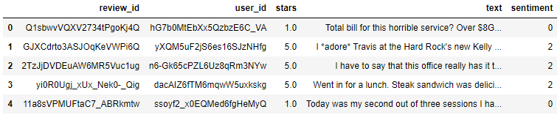
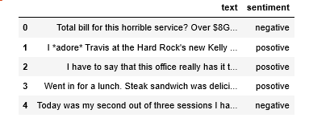
The dataset includes 100,000 reviews from the Yelp website
Insert a dataset of 100.000 rows in Python. The data is in ‘json’ format.
The labels of the reviews were formulated by taking into consideration the ratings of the users. Reviews with 1 or 2 stars are considered as negative, reviews with 3 stars as neutral while reviews with 4 or 5 stars as positive
3

Slide 4
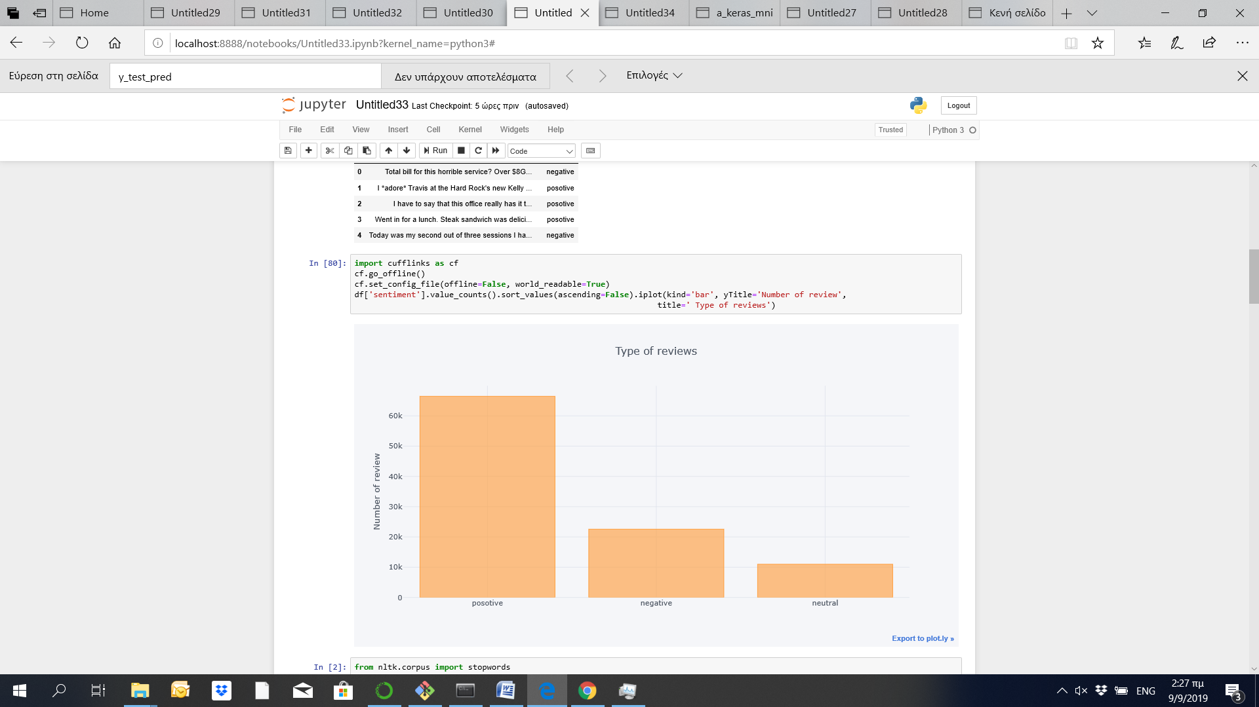
Most of the reviews of the Yelp dataset are positive
Reviews:
65% positive
23% negative
12% neutral
4

Slide 5
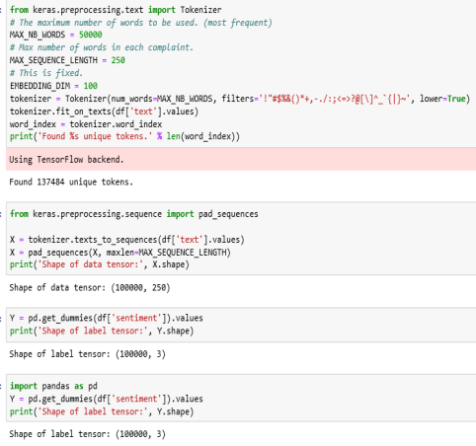
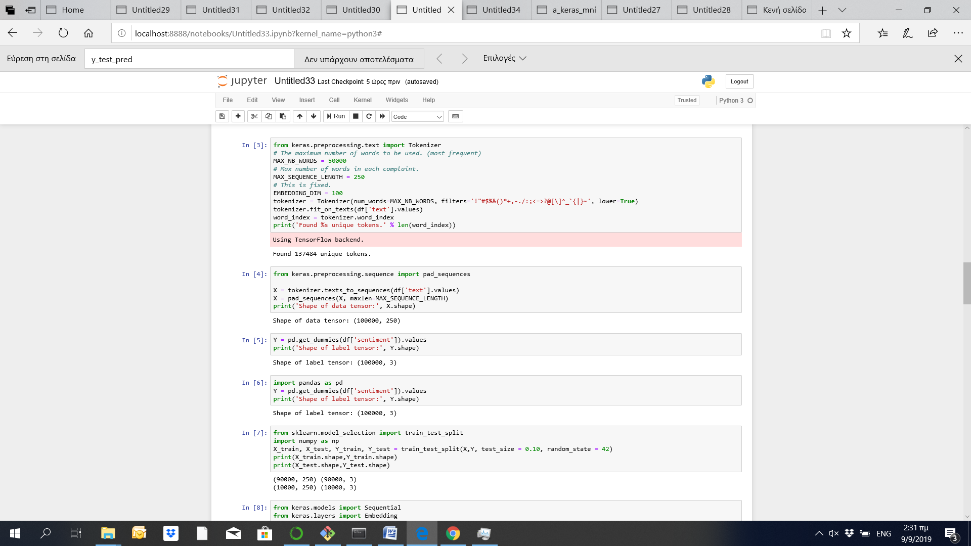
1) Text Classification Using Recurrent neural network (RNN) (1/2)
Preprocessing
Pad sequences
Split the dataset
Converting all text to lower case.
Replace symbols by space in text.
Delete symbols from text.
Delete stop words
Delete digits in text.
Ensure that all sequences in a list have the same length
90% train
10% test
1
2
3
:
:
:
5

Slide 6
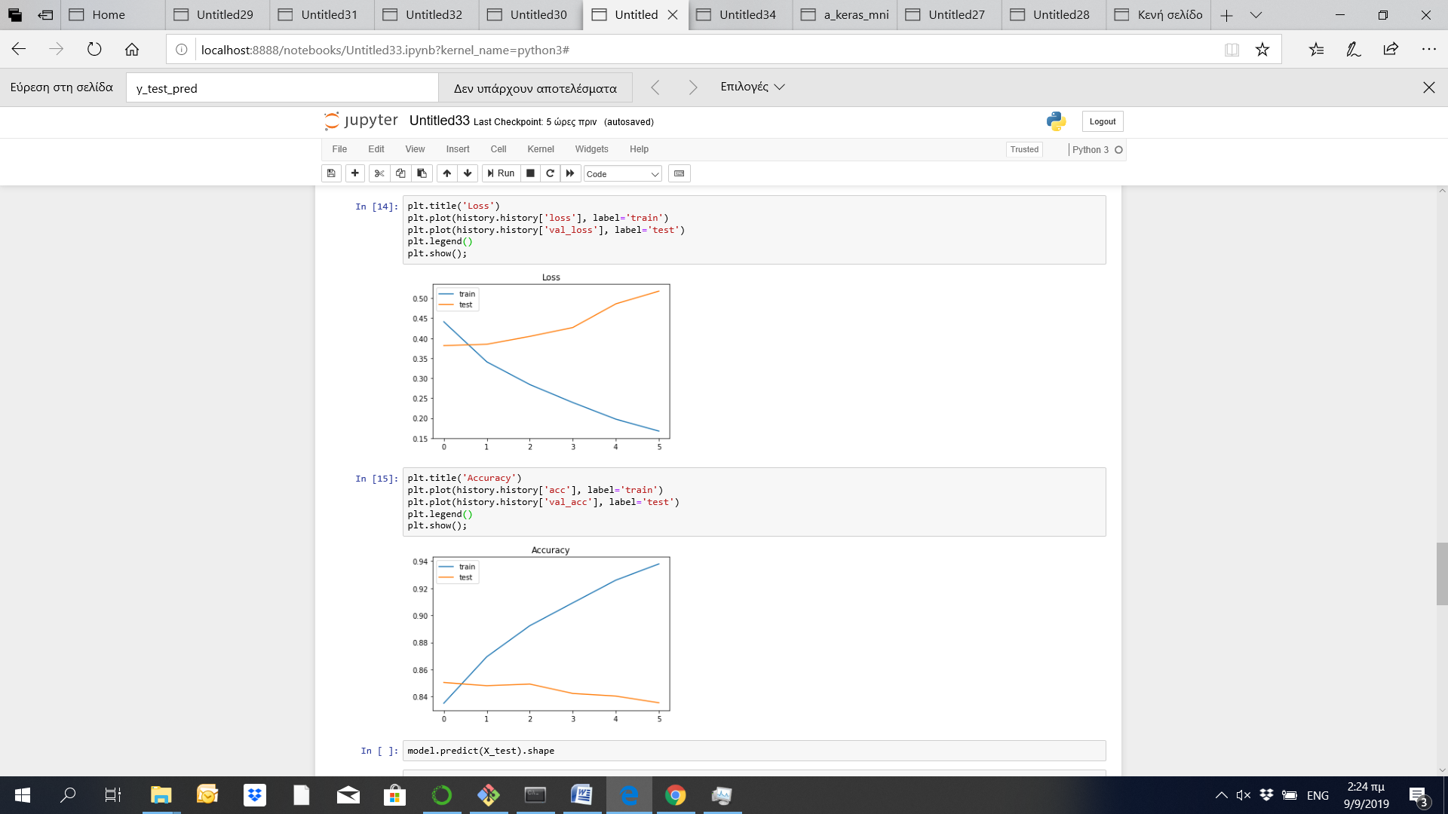
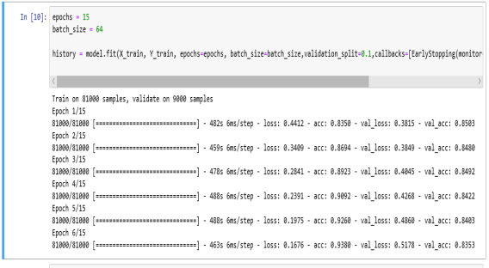
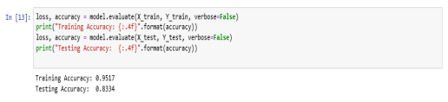
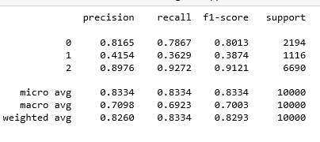
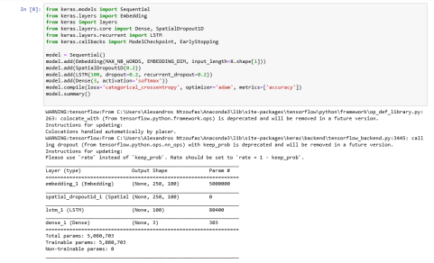
1) Text Classification Using Recurrent neural network (RNN) (2/2)
LSTM - RNN
Train for 15 epochs
Making predictions
Sequential layer
Embedded layer with 100 length vectors
SpatialDropout1D
LSTM layer with 100 memory units
Output layer
Softmax as activation function.
Categorical crossentropy as loss function.
3
1
2
:
:
:
F1 Score:
Negative: 80%
Neutral: 38.7%
Positive: 91.21%
Training accuracy: 95.17%
Testing accuracy: 83.34%
6

Slide 7
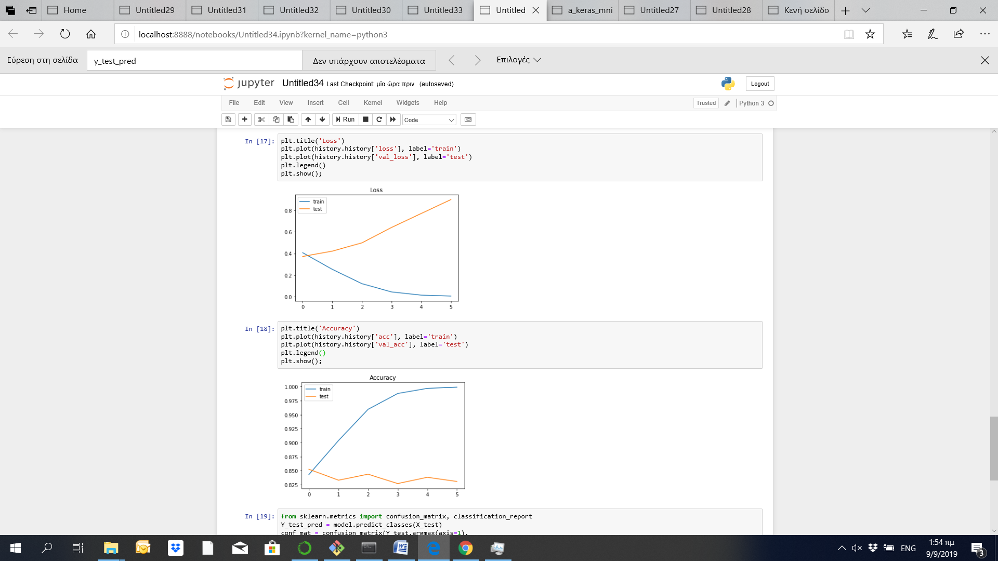
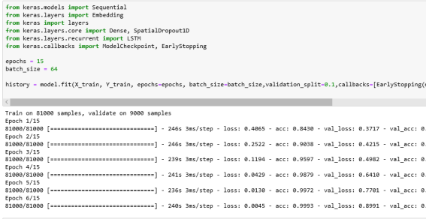
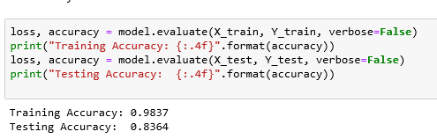
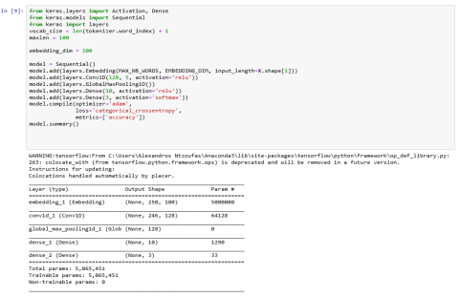
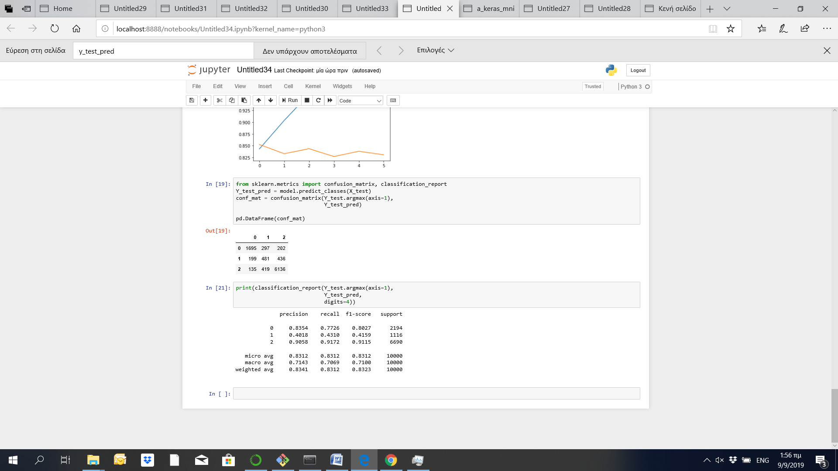
2) Text Classification Using Convolutional Neural Network (CNN)
CNN
Train for 15 epochs
Making predictions
Sequential layer
Embedded layer with 100 length vectors
Conv1D layer
GlobalMaxPooling1D layer
Relu activation function
Softmax as activation function
Categorical_crossentropy is used as loss function.
3
1
2
:
:
:
F1 Score:
Negative: 80.2%
Neutral: 41.6%
Positive: 91.15
Training accuracy: 98.3%
Testing accuracy: 83.6%
7

Slide 8
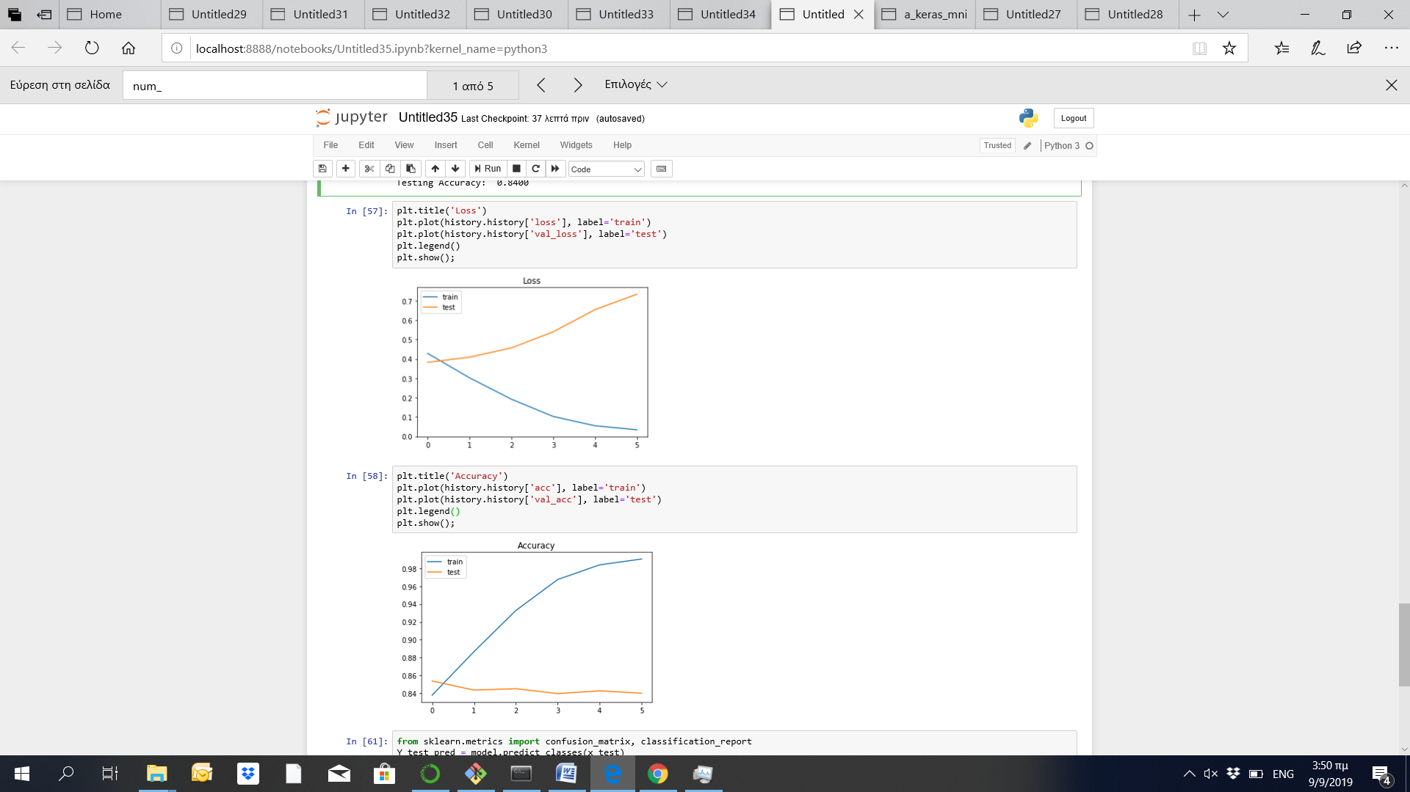
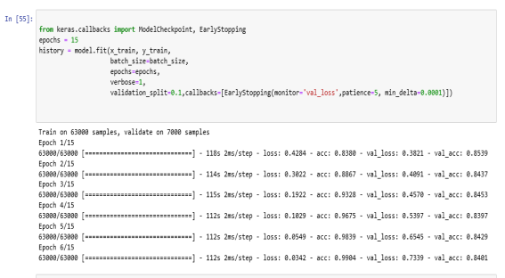
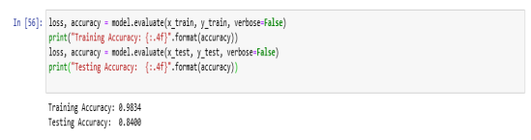
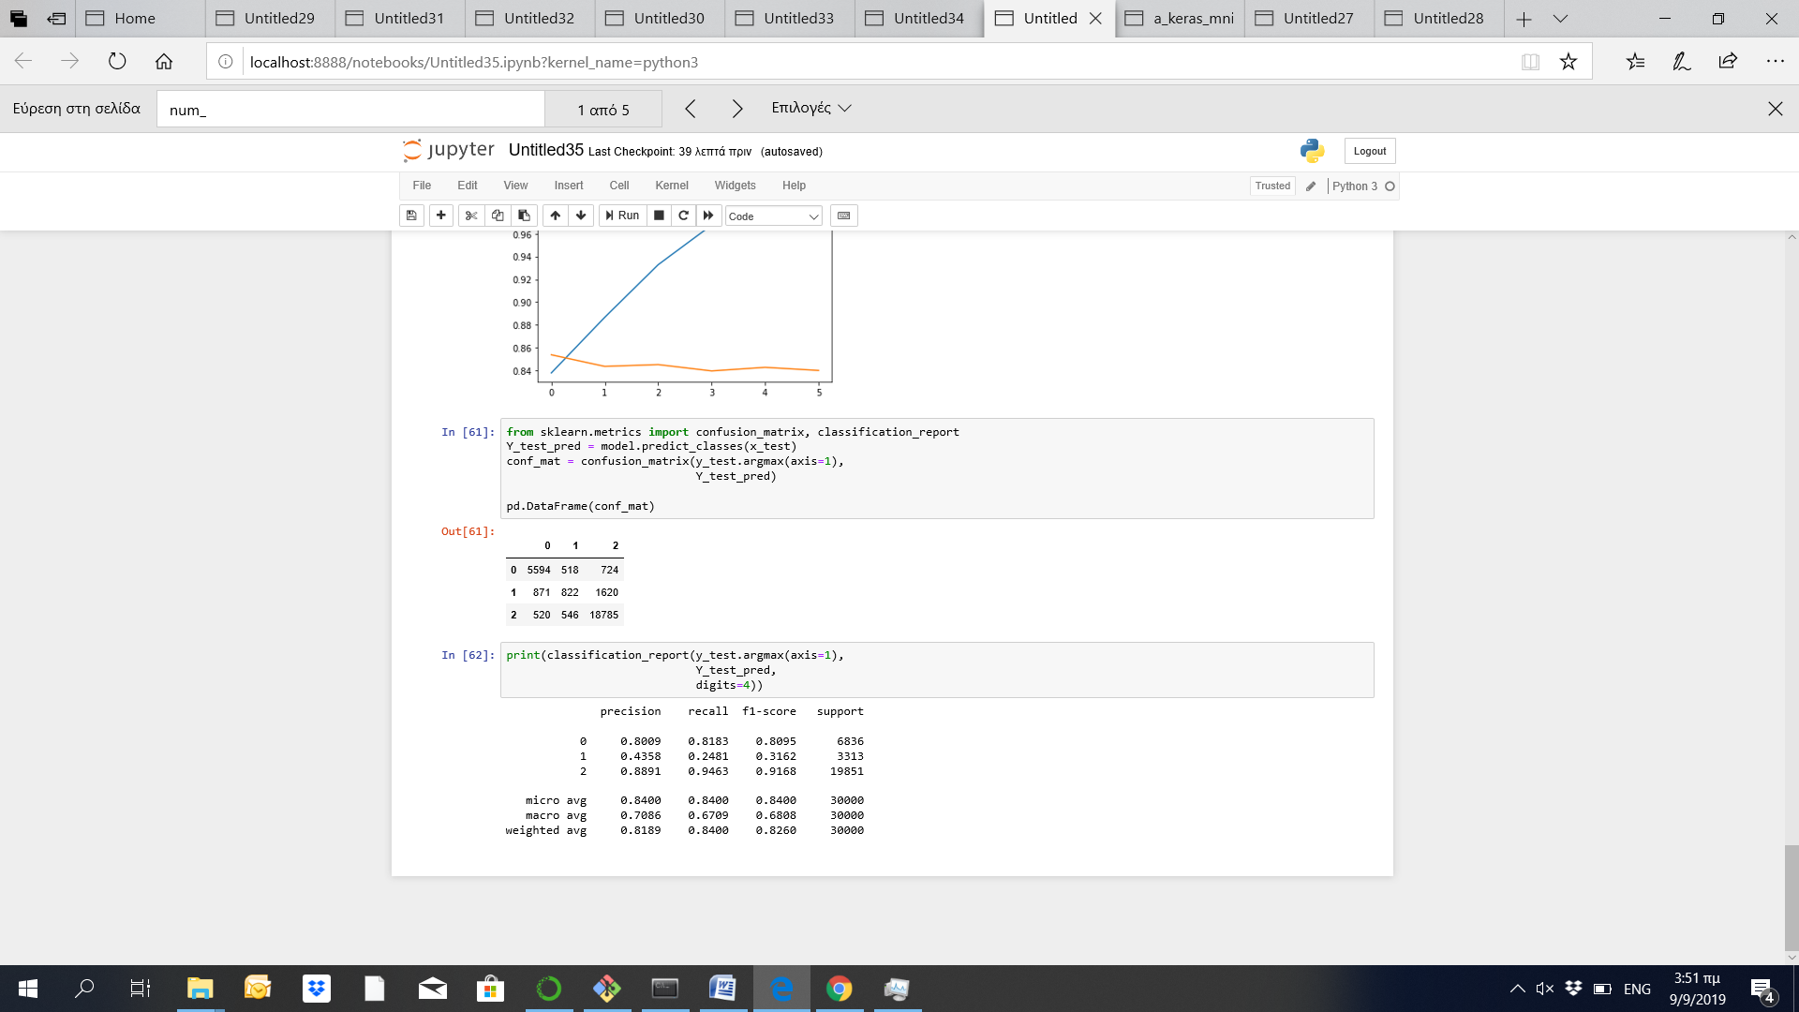

3) Text Classification with a fully connected neural network
Fully connected neural network
Train for 15 epochs
Making predictions
Sequential layer
Dense layer of dense 512 dimensional vectors
Relu activation function
Dropout layer
Dense layer
Softmax as activation function
Categorical crossentropy as loss function.
3
1
2
:
:
:
F1 Score:
Negative: 80.9%
Neutral: 31.6%
Positive: 91.16
Training accuracy: 98.34%
Testing accuracy: 84%
8

Slide 9
Main findings
All models have satisfactory performance
The models predicted better the positive and the negative reviews, while the neutral reviews were predicted with a probability less than 50%
The majority of the comments were positive, less negative and the lower number of reviews was neutral. This may be the reason that the neutral reviews were not predicted as successfully, since the training set was lower.
The performance of the models in terms of accuracy is presented in the following table
Accuracy(%) | Train dataset | Test dataset
LSTM RNN | 95.2% | 83.34%
CNN | 98.3% | 83.6%
Fully connected neural network | 98.3% | 84%
9

Slide 10

Questions ?
10

